Slide 1
MAVERICKS
URBAN FOOD WASTE MANAGEMENT
BY: Pranav Malhotra
Ishan Gupta
Vaibhav Makkar

Slide 2
ZERO HUNGER

Slide 3
FOOD WASTE MANAGEMENT
01
Consumer engagement system
02
Inventory management
03
Smart applicance for household
04
Sustainablility integrated in our solution
A website that connects the consumers with the resturants and shops with surplus food
A software solution that helps reduce waste due to expiration
The solutions to implement real life changes through everyday use
Well thoughout software as well as consious decisions towards the problem statement

Slide 4

Consumer engagement system
01
A platform which is a bridge between
the restaurants and local shops which have surplus foods on the verge of expiration and helps the consumers connect with them

Slide 5
Food hero | academia
01
Award system for financial viability
For the supplier
To be awarded green credits for reducing carbon footprint
A trust based award system for the local community
For the consumer
Loyalty points for helping out the community which can be redeemed later through the app wallet

Slide 6
Food hero | academia
01
In our presented website the data will be collected from restaurants and local grocery shops about the foods that’s tend to get wasted
We connect the ngo in our database to this collected data so that they can reduce the amount of food wasted and help in redistribution of such resources among the community

Slide 7
Further integration
Virtual Food Drives : A virtual reality experience that immerses users in the daily lives of those affected by hunger allowing people to virtually donate food items by participating in interactive simulations, raising awareness and funds simultaneously.
Food Innovation Challenges : Organize nationwide or global competitions to encourage inventors, scientists, and entrepreneurs to create innovative solutions for food production, distribution, and waste reduction.
The Zero Hunger Passport : Create a virtual passport that rewards individuals for participating in hunger-alleviation initiatives including volunteering, supporting local farmers, or donating to food banks. Accumulated points can be redeemed for incentives or discounts at conscious businesses.
Seed Libraries : Establish community seed libraries where individuals can borrow seeds for their home gardens. Encourage urban farming to reduce food miles and empower people to grow their own food, even in limited spaces.

Slide 8
Inventory | Management
02
The goals and challenges of the solution
The seasonal changes in demand and consumption
Unpredictable prices of raw material
Inefficient and non user friendly existing erp systems
Supply chain disruption
Overstocking and understocking

Slide 9
Inventory | Management
02
How our software solution solves these challenges
With a very efficient and accurate demand predictor one can easily plan the orders
With a very simple interface everyone would be comfortable in updating the expiration dates of his stock
With ml techniques forecast in supply and demand can be studied easily by the user
One can easily plan ahead with some margin on how to plan for supply chain disruptions

Slide 10
Inventory | Management
Concept:
In simple analogy terms this inventory management system can be defined as a very strong ERP system and can be used to predict the demand and keep the losses in wastage lower for our client

Slide 11
Smart | Appliances
03
To issue such a challenge we proposed an IOT solution
Inventory Management:
The device should have a built-in camera or barcode scanner to scan food items as they are stored.
Users can manually input items or import data from shopping receipts.
The system will maintain a digital inventory with item names, quantities, and expiration dates.
Expiry Date Tracking:
The device will use AI and machine learning to predict item expiration dates.
Users will be notified when an item is approaching its expiration date through a mobile app or device screen.
An inventory dashboard displays items by expiration date, making it easy for users to identify what needs to be consumed first.
Recipe Suggestions:
The app will suggest recipes based on the items in the user's inventory, including those nearing expiration.
Users can customize dietary preferences and allergies to receive relevant recipe suggestions.
Shopping List Generator:
The device can create a shopping list based on missing ingredients and user preferences.

Slide 12
Sustainability integration
Map integration
Using a map to show the closest locations of the respective user we can reduce the energy spent on transportation
Eco-Labels:
Implement a feature that allows users to easily identify and select food items with eco-labels and certifications, indicating sustainable and environmentally friendly products.
Collaboration with Sustainable Brands:
Partner with sustainable food brands and businesses to promote their products and practices through your platform.

Slide 13
EASY USER-INTERFACE
We try to achieve our goals by making every step of our users as simplified as possible.

Slide 14
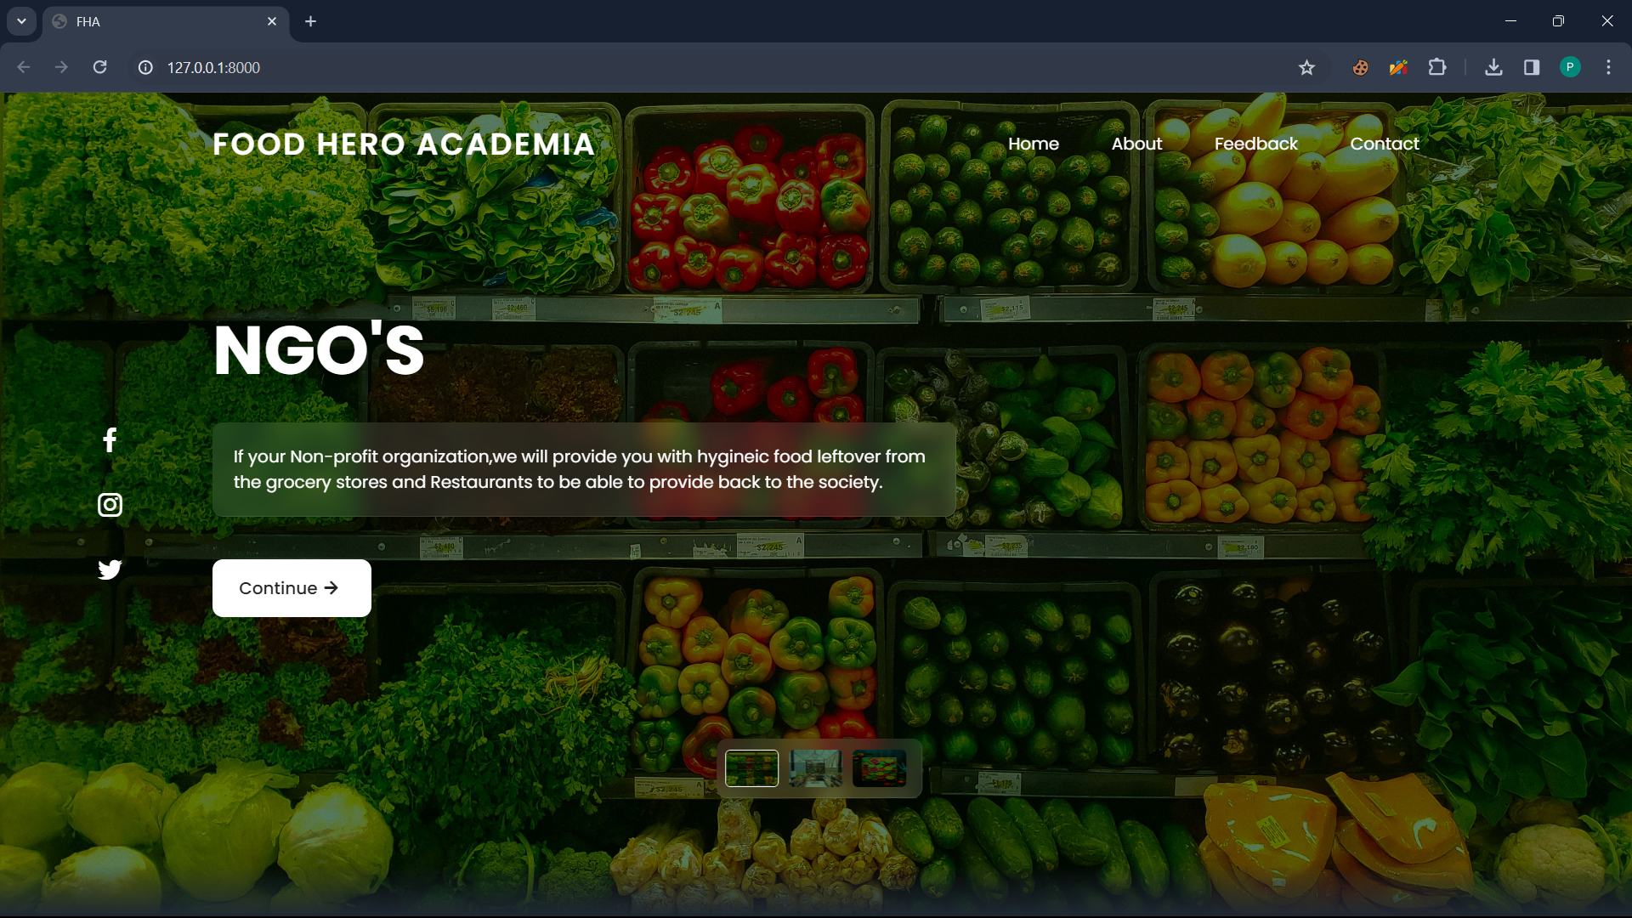
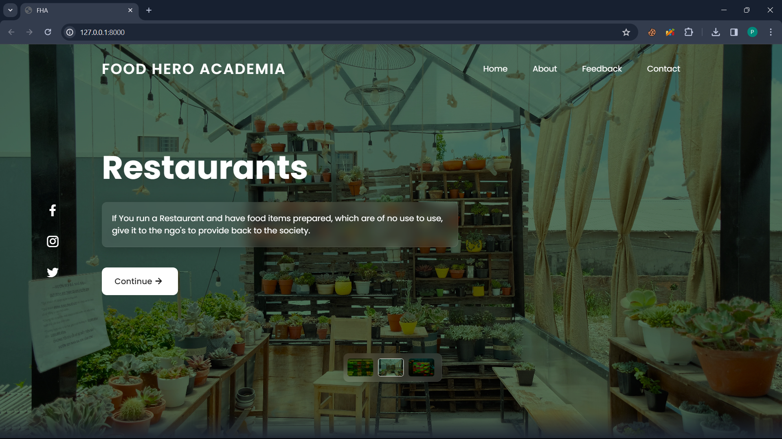
A dedicated page for NGO’s
A dedicated page for Restaurants

Slide 15
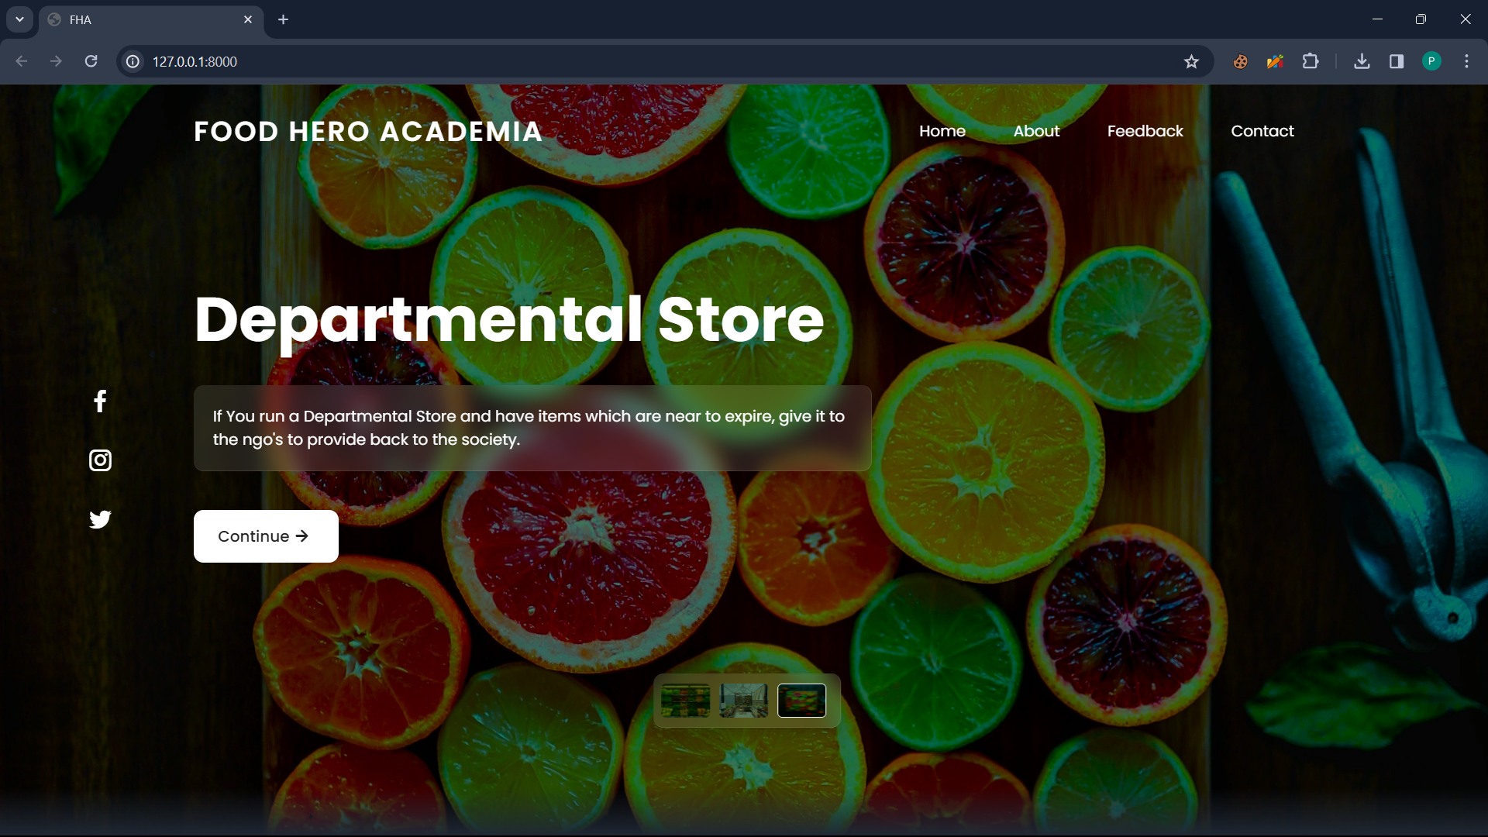
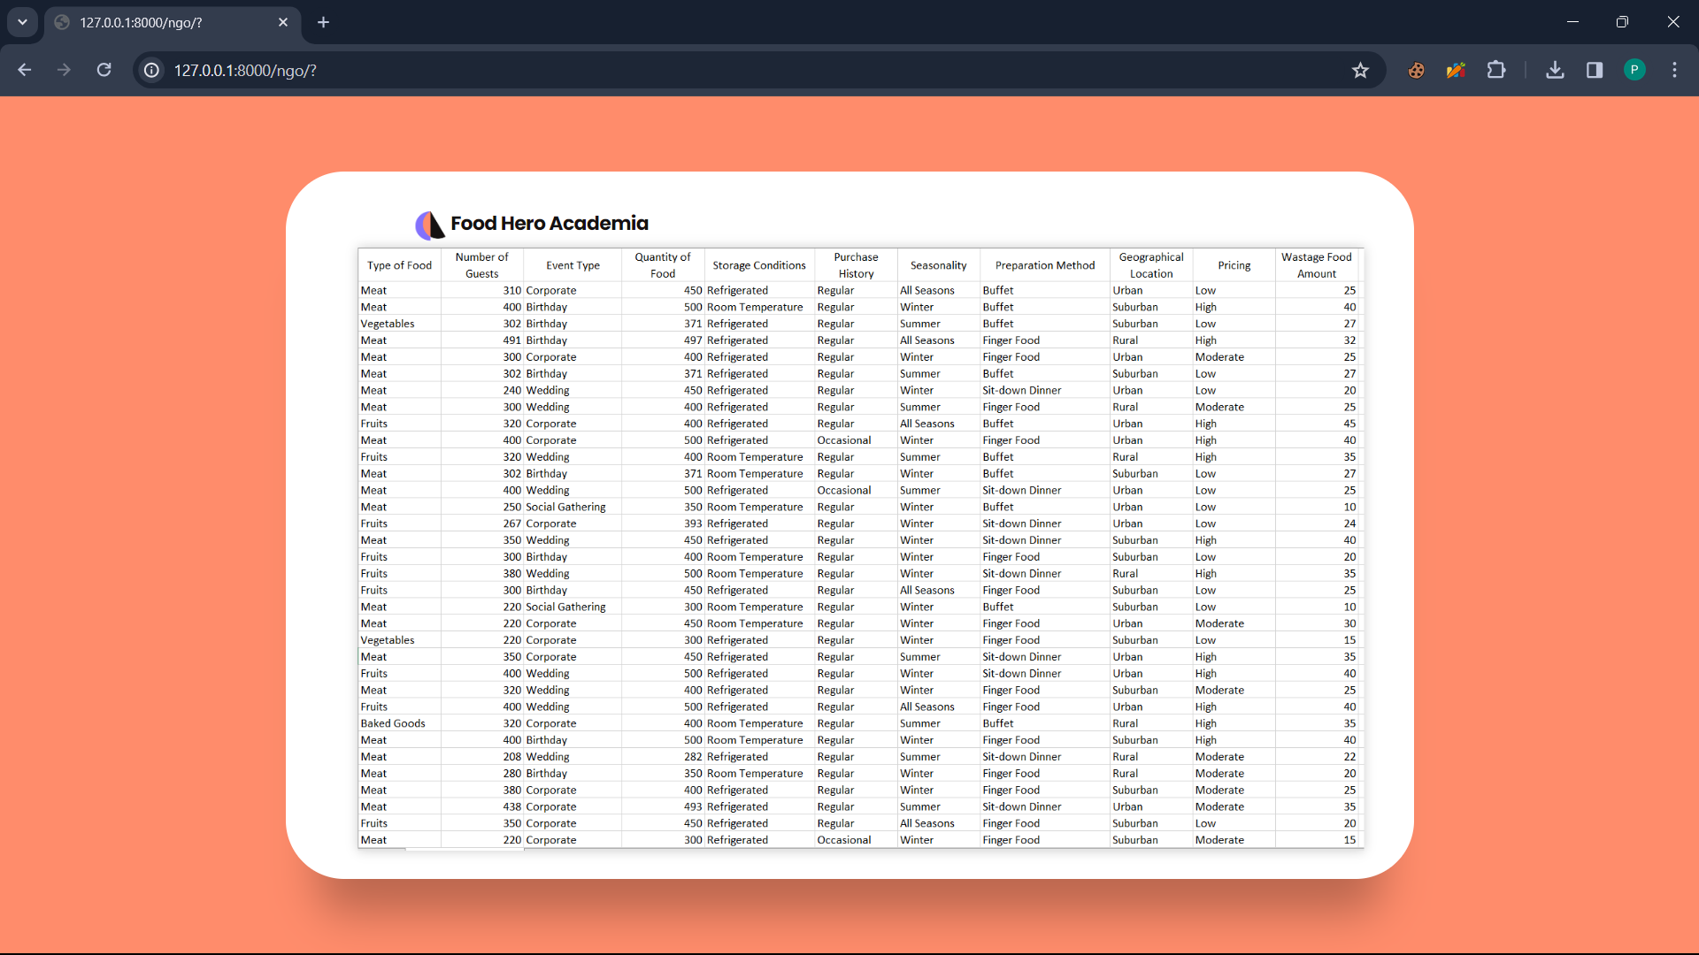
A dedicated page for
Departmental Store
Used AIML for improving food waste management

Slide 16
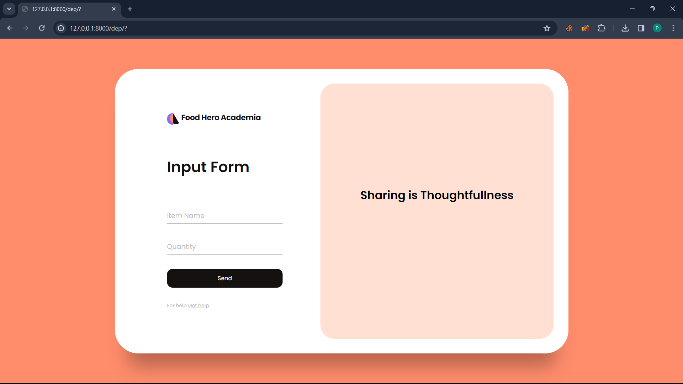

Easy GUI for Data Entry
Login/Sign up page

